Slide 1
Innov8 2.0 Project satya
Omkar Bhandare
​​Rishit Garg
Parth Patil
Nived Shah

Slide 2

About the project
Satya's primary mission is to assist HR professionals in navigating the complex world of resumes, recommendation letters, and professional networks. By leveraging advanced AI techniques, Satya aims to uncover hidden patterns, verify credentials, and provide insightful analysis beyond surface-level information.

Slide 3




Solution
WHY SATYA
WHAT IT DOES
FOR WHOM
IMPACTS
Organizations face significant risks from fraudulent claims, which can lead to poor hiring decisions and impact overall team performance.
Employ robust algorithms to scrutinize Resumes and identify fraud indicators. Provide an easy-to-use interface for screening and ranking candidates.
A large-scale platform targeting efficiency and authenticity in the hiring process via HRs and providing candidates with a fair opportunity to get ranked in their job applications.
Reduce risk of frauds, enhance hiring quality, improve team dynamcis, reduce valuable time-consuming process of manual screening.

Slide 4
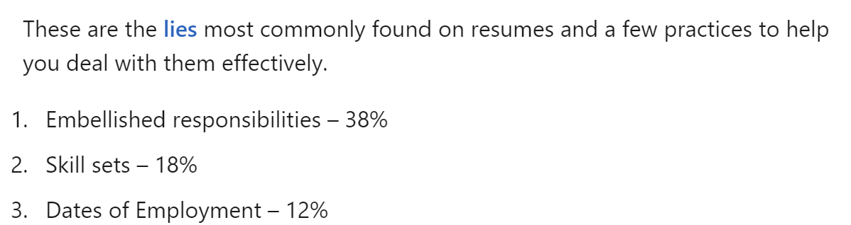
Fraud detection
Vague Phrases
Authenticity of LoRs
Identify phrases that overstate qualifications or show lack of experience
Check specificity of recommendation and flag use of embellished statements
Reciprocal Endorsements
Timeline Inconsistencies
Look for recursive endorsements to identify connections endorsing each other for competitive gain
Evaluate the continuity and progress in a candidate’s career.
LinkedIn

Slide 5
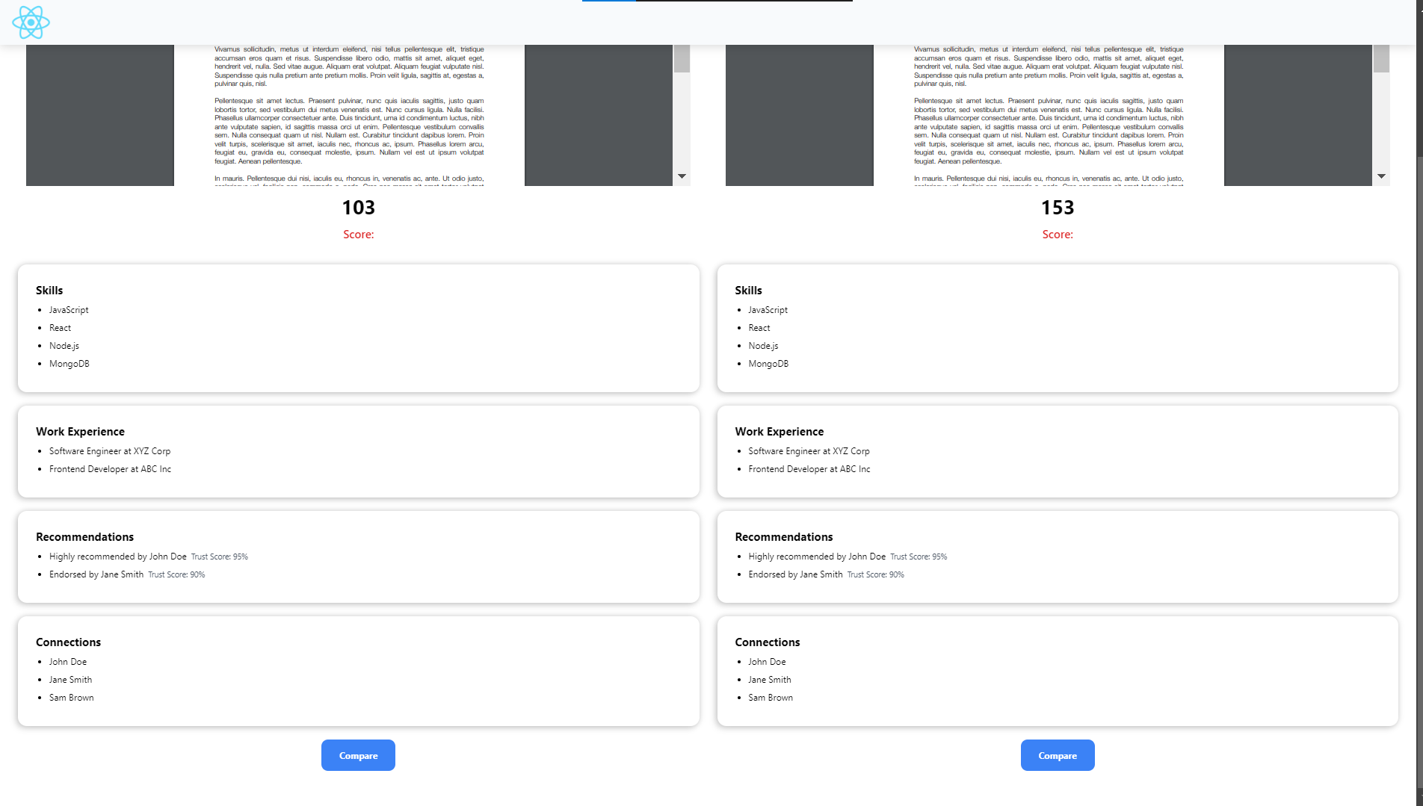
HR DASHBOARD - INSIGHTS
An interactive dashboard for HRs to
View Resume Scores of candidates at a glance
Compare candidates with each other
Define Job Application domains​

Slide 6
TECHNICAL/ analytical Overview

Slide 7
PERFORmance metrics
vagueness
Rec. TRUST score
SKILL TRUST Score
REC. Sentiments
Skill relevance score
Recursive endorsements
Employment gaps
candidate networking

Slide 8
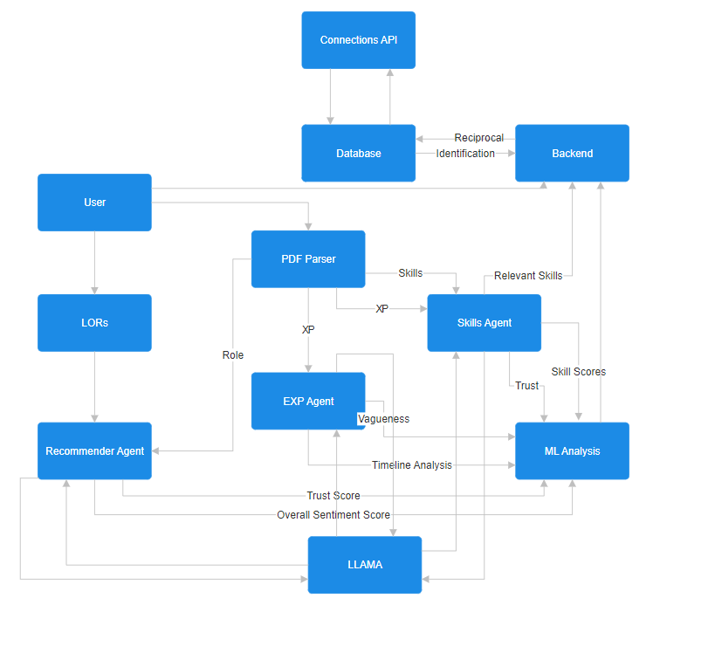
PROCESS FLOWCHART
Modular Software Design, AI Agentic Framework
Different Agents for Candidate scoring and risk analysis
Offload Heavy Lifting by analysing at the time of entry
Maximize the use of LLMs (one-time expense)
MERN Stack for Web Application, with FastAPI implementation of Analysis

Slide 9
Scalability/optimization
How we’ll scale and optimise in the future
Architecture
Versatile agentic framework
adaptability
Time
trade-offs
System rollout to handle increasing volumes of data without compromising performance
Continuous updates will be made to incorporate more sections of the applicant’s CV
The use of more powerful models increases our accuracy without any effort
No query-time processing, thus faster to access data multiple times

Slide 10
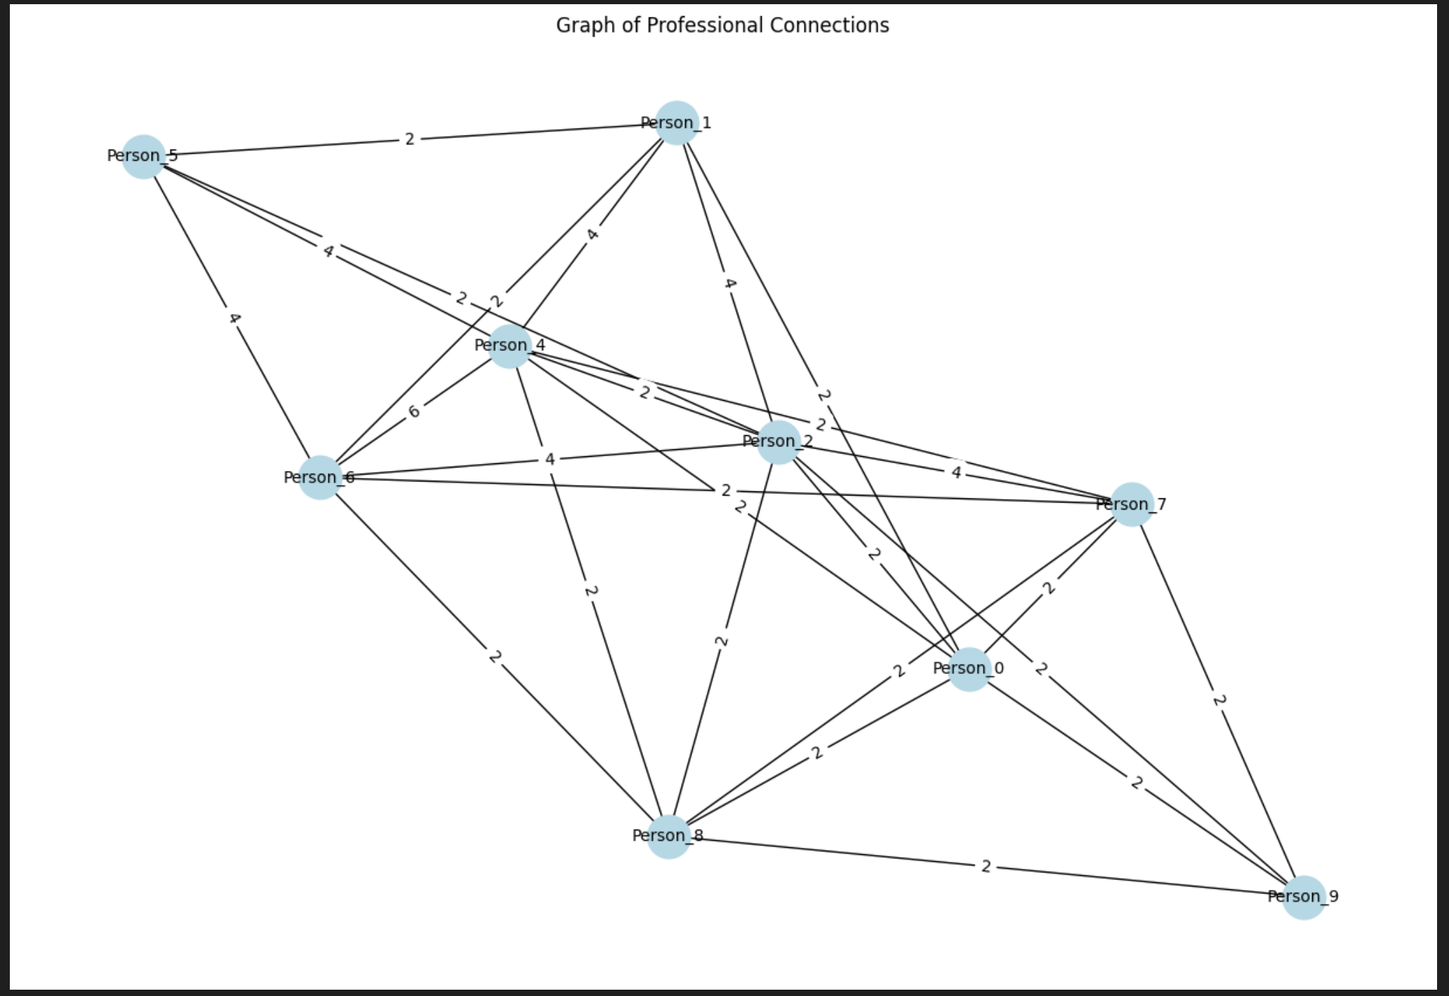
NETWORking analysis
Degree Centrality: Measures direct connections; individuals with a high degree of centrality are influential, well-connected, and can access information quickly.
Betweenness Centrality: Reflects how often someone bridges between others; high betweenness indicates control over information flow and cross-group collaboration.
Closeness Centrality: Indicates proximity to others in the network; high closeness means faster access to people and resources, aiding efficient communication.
Clustering Coefficient: Measures how tightly-knit a person’s connections are; high clustering suggests strong group relationships and potential team cohesion.

Slide 11
Summary
Our implementation of Satya marks a key advancement in AI-driven HR decision-making. By utilizing advanced LLaMA-based models and analysis techniques, the system delivers comprehensive CV evaluations, detects fraudulent claims, and offers scalable, adaptable solutions to evolving HR needs. Satya's multi-faceted approach to resume scoring empowers HR professionals with deeper insights, ensuring informed hiring decisions while continuously delivering value as data volumes and market trends grow.

Slide 12
Thank you

